Slide 1
SVG
Creating Vector Graphics in the Web
Telerik Software Academy
Learning & Development
http://academy.telerik.com

Slide 2
Table of Contents
SVG Overview
Vector Graphics Overview
Basic SVG Shapes
Rectangular
Ellipse
Path
Text

Slide 3
SVG Overview
What is SVG?

Slide 4
SVG Overview
SVG is a technology for describing two dimensional vector graphics
Uses an extension of XML
SVG stands for Scalable Vector Graphics
SVG is platform independent
Understood by most browsers

Slide 5
Vector Graphics Overview
Vector graphics are based on mathematical expressions
The same on any resolution and zoom level and are not pixelated
Consist of geometrical primitives such as:
Points
Lines and curves
Shapes or polygons
Represent images in computer graphics
Vectors are locations in a dimensional space

Slide 6
Using SVG in a web page
To use SVG you need to simply open the <svg> element and to start defining your shapes using XML notation
<svg width="300" height="450">
<rect x="50" y="50" width="150" height="150" fill="lightblue" />
<circle cx="125" cy="125" r="60" stroke="none" fill="darkblue" />
</svg>

Slide 7
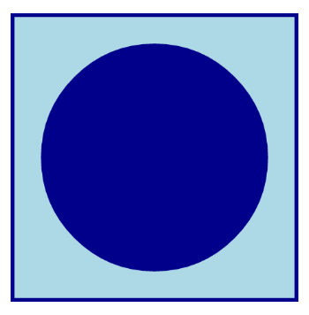
Using SVG in a web page
To use SVG you need to simply open the <svg> element and to start defining your shapes using XML notation
<svg width="300" height="450">
<rect x="50" y="50" width="150" height="150" fill="lightblue" />
<circle cx="125" cy="125" r="60" stroke="none" fill="darkblue" />
</svg>

Slide 8
Using SVG in a web page
To use SVG you need to simply open the <svg> element and to start defining your shapes using XML notation
<svg width="300" height="450">
<rect x="50" y="50" width="150" height="150" fill="lightblue" />
<circle cx="125" cy="125" r="60" stroke="none" fill="darkblue" />
</svg>
SVG uses a coordinate system for the sizes and positions

Slide 9
Simple SVG
Live Demo

Slide 10
SVG Shapes
What has SVG to offer?

Slide 11
SVG Shapes
As mentioned, vector graphics are built from graphic primitives
Points
Lines and curves
Shapes: rectangular, circle, etc…
SVG supports most of the basic shapes
More complex shapes can be created using the basic ones

Slide 12
SVG Shapes: Line
<line> is the most basic shape in SVG
Creates a line between two points
<line x1="0" y1="0"
x2="300" y2="450" stroke="black" />
<line x1="300" y1="0"
x2="0" y2="450" stroke="black" />
<line x1="0" y1="150"
x2="300" y2="150" stroke="black" />
<line x1="0" y1="300"
x2="300" y2="300" stroke="black" />
<line x1="0" y1="150"
x2="300" y2="300" stroke="black" />
<line x1="0" y1="300"
x2="300" y2="150" stroke="black" />

Slide 13
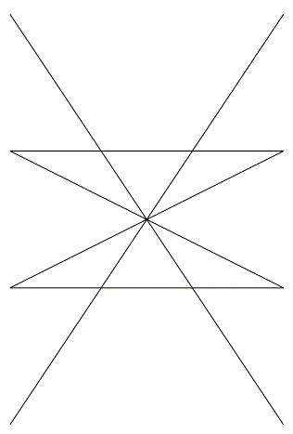
SVG Shapes: Line
<line> is the most basic shape in SVG
Creates a line between two points
<line x1="0" y1="0"
x2="300" y2="450" stroke="black" />
<line x1="300" y1="0"
x2="0" y2="450" stroke="black" />
<line x1="0" y1="150"
x2="300" y2="150" stroke="black" />
<line x1="0" y1="300"
x2="300" y2="300" stroke="black" />
<line x1="0" y1="150"
x2="300" y2="300" stroke="black" />
<line x1="0" y1="300"
x2="300" y2="150" stroke="black" />

Slide 14
SVG Shapes: Line
<line> is the most basic shape in SVG
Creates a line between two points
<line x1="0" y1="0"
x2="300" y2="450" stroke="black" />
<line x1="300" y1="0"
x2="0" y2="450" stroke="black" />
<line x1="0" y1="150"
x2="300" y2="150" stroke="black" />
<line x1="0" y1="300"
x2="300" y2="300" stroke="black" />
<line x1="0" y1="150"
x2="300" y2="300" stroke="black" />
<line x1="0" y1="300"
x2="300" y2="150" stroke="black" />
Stroke sets the color of the line

Slide 15
Defining Lines with SVG
Live Demo

Slide 16
SVG Shapes: Rects and Circles
<rect> creates a rectangular with a top-left position, width and height
<circle> creates a circle with center and radius
<rect x="10" y="10" width="280" height="280" fill="#222"/>
<circle cx="150" cy="150" r="135" fill="#333"/>
<rect x="55" y="55" width="190" height="190" fill="#444"/>
<circle cx="150" cy="150" r="95" fill="#555"/>
<rect x="85" y="85" width="130" height="130" fill="#666"/>
<circle cx="150" cy="150" r="65" fill="#777"/>
<rect x="105" y="105" width="90" height="90" fill="#888"/>
<circle cx="150" cy="150" r="45" fill="#999"/>

Slide 17
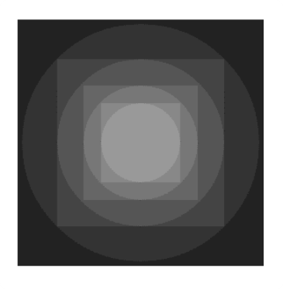
SVG Shapes: Rects and Circles
<rect> creates a rectangular with a top-left position, width and height
<circle> creates a circle with center and radius
<rect x="10" y="10" width="280" height="280" fill="#222"/>
<circle cx="150" cy="150" r="135" fill="#333"/>
<rect x="55" y="55" width="190" height="190" fill="#444"/>
<circle cx="150" cy="150" r="95" fill="#555"/>
<rect x="85" y="85" width="130" height="130" fill="#666"/>
<circle cx="150" cy="150" r="65" fill="#777"/>
<rect x="105" y="105" width="90" height="90" fill="#888"/>
<circle cx="150" cy="150" r="45" fill="#999"/>

Slide 18
Circles and Rectangles
Live Demo

Slide 19
SVG Paths

Slide 20
SVG Paths
SVG can define more complex shapes using the path
Create straight line from a point to other point
Create a curve between two points
Used with the element <path>
Add giving commands and points for the lines using the "d" attribute
<path d="M 50 50 L 175 310 H210" ></path>

Slide 21
SVG Paths: Commands
The path commands are as follows:
M x y or m x y
Moves the path marker to position (x, y)
L x y or l x y
Creates a straight line between the marker point and point (x, y)
(H x or h x) and (V y or v y)
Creates a horizontal/vertical line from the marker point to the given point
Z or z
Closes the path, connects the first and last points

Slide 22
SVG Paths: Line Commands
Paths example
Drawing the letters "R" and "E"
<path stroke="yellowgreen" fill="none"
d="M 375 50 H 450 M 375 50 V 150 H 450 M 375 100 H 430" />
<path stroke="yellowgreen" fill="none" d="M 475 50 V 150 M 475 50 H 525 L 550 75 V 100 H 475 L 550 150" />

Slide 23
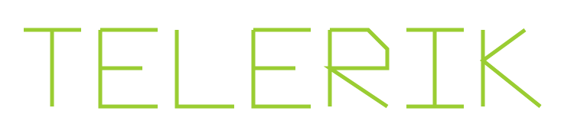
SVG Paths: Line Commands
Paths example
Drawing the letters "R" and "E"
<path stroke="yellowgreen" fill="none"
d="M 375 50 H 450 M 375 50 V 150 H 450 M 375 100 H 430" />
<path stroke="yellowgreen" fill="none" d="M 475 50 V 150 M 475 50 H 525 L 550 75 V 100 H 475 L 550 150" />

Slide 24
SVG Paths: Line Commands
Live Demo

Slide 25
SVG Paths: Curves
C x1 y1 x2 y2 x y
Cubic Bezier curve
Two control points: (x1, y1) and (x2, y2)
Ending point at (x, y)
S x2 y2 x y continues the curve
Q x1 y1 x y
Quadratic Bezier curve
One control point: (x1, y1)
Ending point at (x, y)
T x y continues the curve

Slide 26
SVG Paths: Curves Example
Drawing quadratic and cubic Bezier curves:
<path d="M50 200 C60 450 145 300 200 200
S225 50 300 200" />

Slide 27
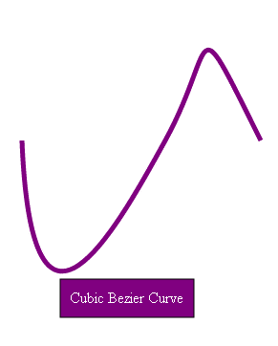
SVG Paths: Curves Example
Drawing quadratic and cubic Bezier curves:
<path d="M50 200 C60 450 145 300 200 200
S225 50 300 200" />

Slide 28
SVG Paths: Curves Example
Drawing quadratic and cubic Bezier curves:
<path d="M50 200 C60 450 145 300 200 200
S225 50 300 200" />
<path d="M350 200 Q360 450 400 200 T525 200" />

Slide 29
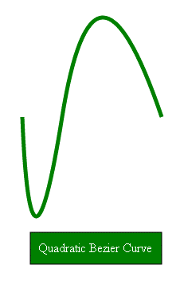
SVG Paths: Curves Example
Drawing quadratic and cubic Bezier curves:
<path d="M50 200 C60 450 145 300 200 200
S225 50 300 200" />
<path d="M350 200 Q360 450 400 200 T525 200" />

Slide 30
SVG Paths: Curves Example
Drawing quadratic and cubic Bezier curves:
<path d="M50 200 C60 450 145 300 200 200
S225 50 300 200" />
The path points must be on the same line!
The path points must be on the same line!
<path d="M350 200 Q360 450 400 200 T525 200" />

Slide 31
SVG Paths: Curves
Live Demo

Slide 32
SVG DOM API
Using SVG with JavaScript

Slide 33
SVG DOM API
SVG is XML
SVG elements can be selected just as DOM elements
getElementsByXXX(…) and querySelector(…)
SVG elements can be created dynamically
document.createElement('rect')
var svgNS = 'http://www.w3.org/2000/svg';
var rect = document.createElementNS(svgNs, 'rect');
rect.setAttribute('x', x);
rect.setAttribute('y', y);
rect.setAttribute('width', width);
rect.setAttribute('height', height);
document.getElementById('the-svg').appendChild(rect);

Slide 34
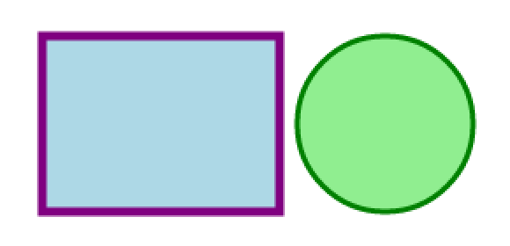
SVG Styles
SVG elements can also be styled with CSS:
<svg id='the-svg' …>
<rect … />
</rect>
<circle … />
</svg>
SVG:
#the-svg rect{
fill: 'white'
stroke: 'purple'
stroke-width: '5'
}
CSS:

Slide 35
SVG DOM and Styles
Live Demo

Slide 36
SVG
http://academy.telerik.com

Slide 37
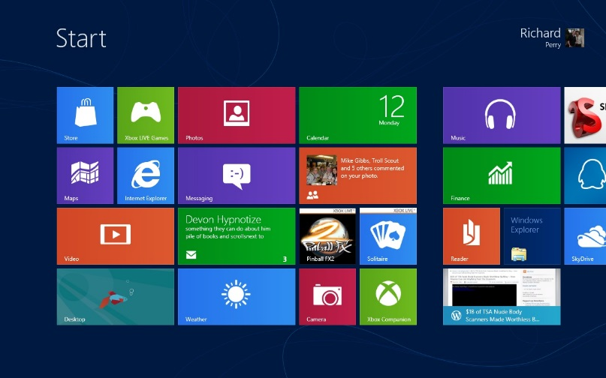

Homework
Implement the image (MEAN) with SVG
Use both circles and paths
Implement the Windows 8 start screen with SVG
*Implement the first two tasks using the SVG DOM API and JavaScript

